Slide 1
Intro to Databases Lesson 1

Slide 2
Why are we here?
We're here to learn how to persist data. (Keep it around for later use).

Slide 3

What is a database?
“A database is an organized collection of data, generally stored and accessed electronically from a computer system.” -Wikipedia
Notes:
According to Wikipedia...

Slide 4
What is a database?
A place to store your data
Notes:
More simply - you can think of it as a place to store your data.

Slide 5

Notes:
Let’s say you wanted to build an application to display information about shipwrecks. You could store that information in a database. Let’s take a look at how you would do that while we discuss some key database terms.

Slide 6
Key Terms

Slide 7
DOCUMENT
A document is a structure composed of key and value pairs, similar to JSON objects.
Notes:
A document stores information about an object.

Slide 8
{ "_id" : ObjectId("578f6fa2df35c7fbdbaed8c4"), "feature_type" : "Wrecks - Visible", "chart" : "US,U1,graph,DNCH1409860", "latdec" : 9.3547792, "londec" : -79.9081268, "depth" : "", "watlev" : "always dry", "coordinates" : [
-79.9081268,
9.3547792 ]
}
Notes:
A document stores information about an object.

Slide 9
{ "_id" : ObjectId("578f6fa2df35c7fbdbaed8c4"), "feature_type" : "Wrecks - Visible", "chart" : "US,U1,graph,DNCH1409860", "latdec" : 9.3547792, "londec" : -79.9081268, "depth" : "", "watlev" : "always dry", "coordinates" : [
-79.9081268,
9.3547792 ]
}
Notes:
Each document begins and ends with curly braces - see the red little things.

Slide 10
{ "_id" : ObjectId("578f6fa2df35c7fbdbaed8c4"), "feature_type" : "Wrecks - Visible", "chart" : "US,U1,graph,DNCH1409860", "latdec" : 9.3547792, "londec" : -79.9081268, "depth" : "", "watlev" : "always dry", "coordinates" : [
-79.9081268,
9.3547792 ]
}
Notes:
Fields

Slide 11
{ "_id" : ObjectId("578f6fa2df35c7fbdbaed8c4"), "feature_type" : "Wrecks - Visible", "chart" : "US,U1,graph,DNCH1409860", "latdec" : 9.3547792, "londec" : -79.9081268, "depth" : "", "watlev" : "always dry", "coordinates" : [
-79.9081268,
9.3547792 ]
}
Notes:
Values

Slide 12
{ "_id" : ObjectId("578f6fa2df35c7fbdbaed8c4"), "feature_type" : "Wrecks - Visible", "chart" : "US,U1,graph,DNCH1409860", "latdec" : 9.3547792, "londec" : -79.9081268, "depth" : "", "watlev" : "always dry", "coordinates" : [
-79.9081268,
9.3547792 ]
}
Notes:
ObjectId - a unique identifier for each document.

Slide 13
{ "_id" : ObjectId("578f6fa2df35c7fbdbaed8c4"), "feature_type" : "Wrecks - Visible", "chart" : "US,U1,graph,DNCH1409860", "latdec" : 9.3547792, "londec" : -79.9081268, "depth" : "", "watlev" : "always dry", "coordinates" : [
-79.9081268,
9.3547792 ]
}
Notes:
Strings
Depth:
In this case, depth is stored as empty string, which is ok. You could also choose to store depth as a number, which would probably be better. If you stored it as a number, you could perform calculations and comparisons on the values.
You could also choose to omit the field completely. One of the strengths of document databases is that not every document needs to have the same fields, which gives you a lot of flexibility in how you model and store your data.

Slide 14
{ "_id" : ObjectId("578f6fa2df35c7fbdbaed8c4"), "feature_type" : "Wrecks - Visible", "chart" : "US,U1,graph,DNCH1409860", "latdec" : 9.3547792, "londec" : -79.9081268, "depth" : "", "watlev" : "always dry", "coordinates" : [
-79.9081268,
9.3547792 ]
}
Notes:
You can store a variety of numbers: integers, floats, decimals

Slide 15
{ "_id" : ObjectId("578f6fa2df35c7fbdbaed8c4"), "feature_type" : "Wrecks - Visible", "chart" : "US,U1,graph,DNCH1409860", "latdec" : 9.3547792, "londec" : -79.9081268, "depth" : "", "watlev" : "always dry", "coordinates" : [
-79.9081268,
9.3547792 ]
}
Notes:
Arrays: In this case, we have an array of numbers. We could have an array of a variety of types. For example, we might have an array of Strings if we want to store a list of people who have owned the ship.

Slide 16
COLLECTION
A group of documents.
Notes:
Typically, collections contain documents of related data.

Slide 17
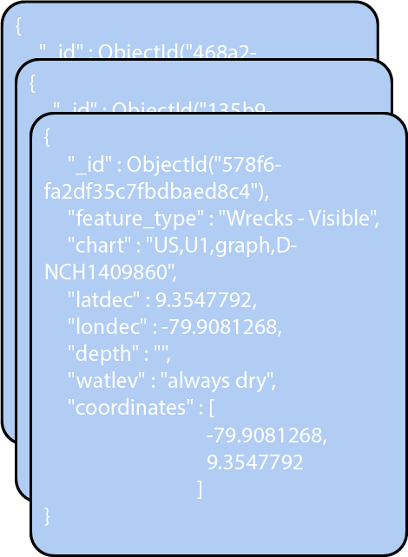
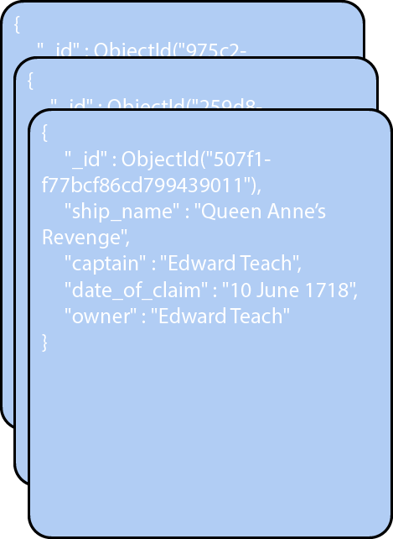
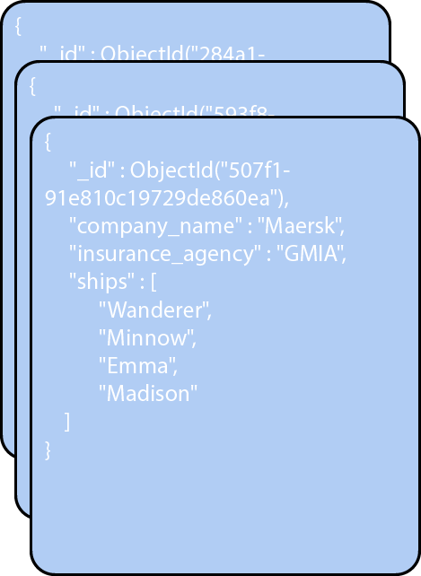
shipwrecks
insurance
company

Slide 18
DATABASE
A database contains a group of collections.

Slide 19
ShipInfo
shipwrecks
insurance
company

Slide 20
MongoDB Atlas
Notes:
Atlas is a hosted database, so you don’t have to set it up and manage it yourself. We’ll be using Atlas for storing our data.
Atlas demo:
Logging in
Navigating to your demo project
A cluster contains your database. I’ve already loaded shipwreck data into a database on this cluster. I can choose to browse the data here, or I can browse it in Compass. Let’s take a look in Compass.
Compass demo:
Show the shipwreck data in the Documents tab
Schema tab → Analyze schema to see what type of data is in the database

Slide 21
Let’s model data together!
Notes:
If you have extra time, use a whiteboard to walk through how you could model data for a specific example. For example, you might want to walk through how you could model data for an online store like Amazon. Discuss and sketch how you would model data for products, customers, and orders. Consider what your documents, collections, and databases would look like.

Slide 22
Woo! You learned a lot.
What a database is, how you can store data in documents, how you can store documents in collections and collections in databases, and how you can import your own data into a database. Impressive!

Slide 23
Intro to Databases Lesson 2
Notes:
In this lesson, we’re going to learn how to interact with the data in your database. Storing data in your database is not that helpful unless you can retrieve it to do something useful. Today we’re going to learn how to do just that.

Slide 24
What will you do with a database?
You query it!
Notes:
A query is the term we use for a request you make to the database.

Slide 25
What will you do with a database?
You query it!
CRUD Operations
Create
Read
Update
Delete
Notes:
When people talk about database queries, they usually use the term “CRUD,” which stands for Create, Read, Update, and Delete. These operations define the ways you can interact with data in your database.
The rest of this lesson is going to be a demo. I’m going to walk you through how to write queries for each of the CRUD operations. Then I’m going to spend the last few minutes showing you how to create charts for your data.

Slide 26
Woo! You learned a lot.
What a query is, how to create, read, update, and delete data in a database, how to quickly visualize data, and how to embed those visualizations in your app or blog. Nice!

